Slide 1
Interactive Kanban Board
Group 1

Slide 2
Introduction
Notes:
Give you a short intro about us, our client and product

Slide 3
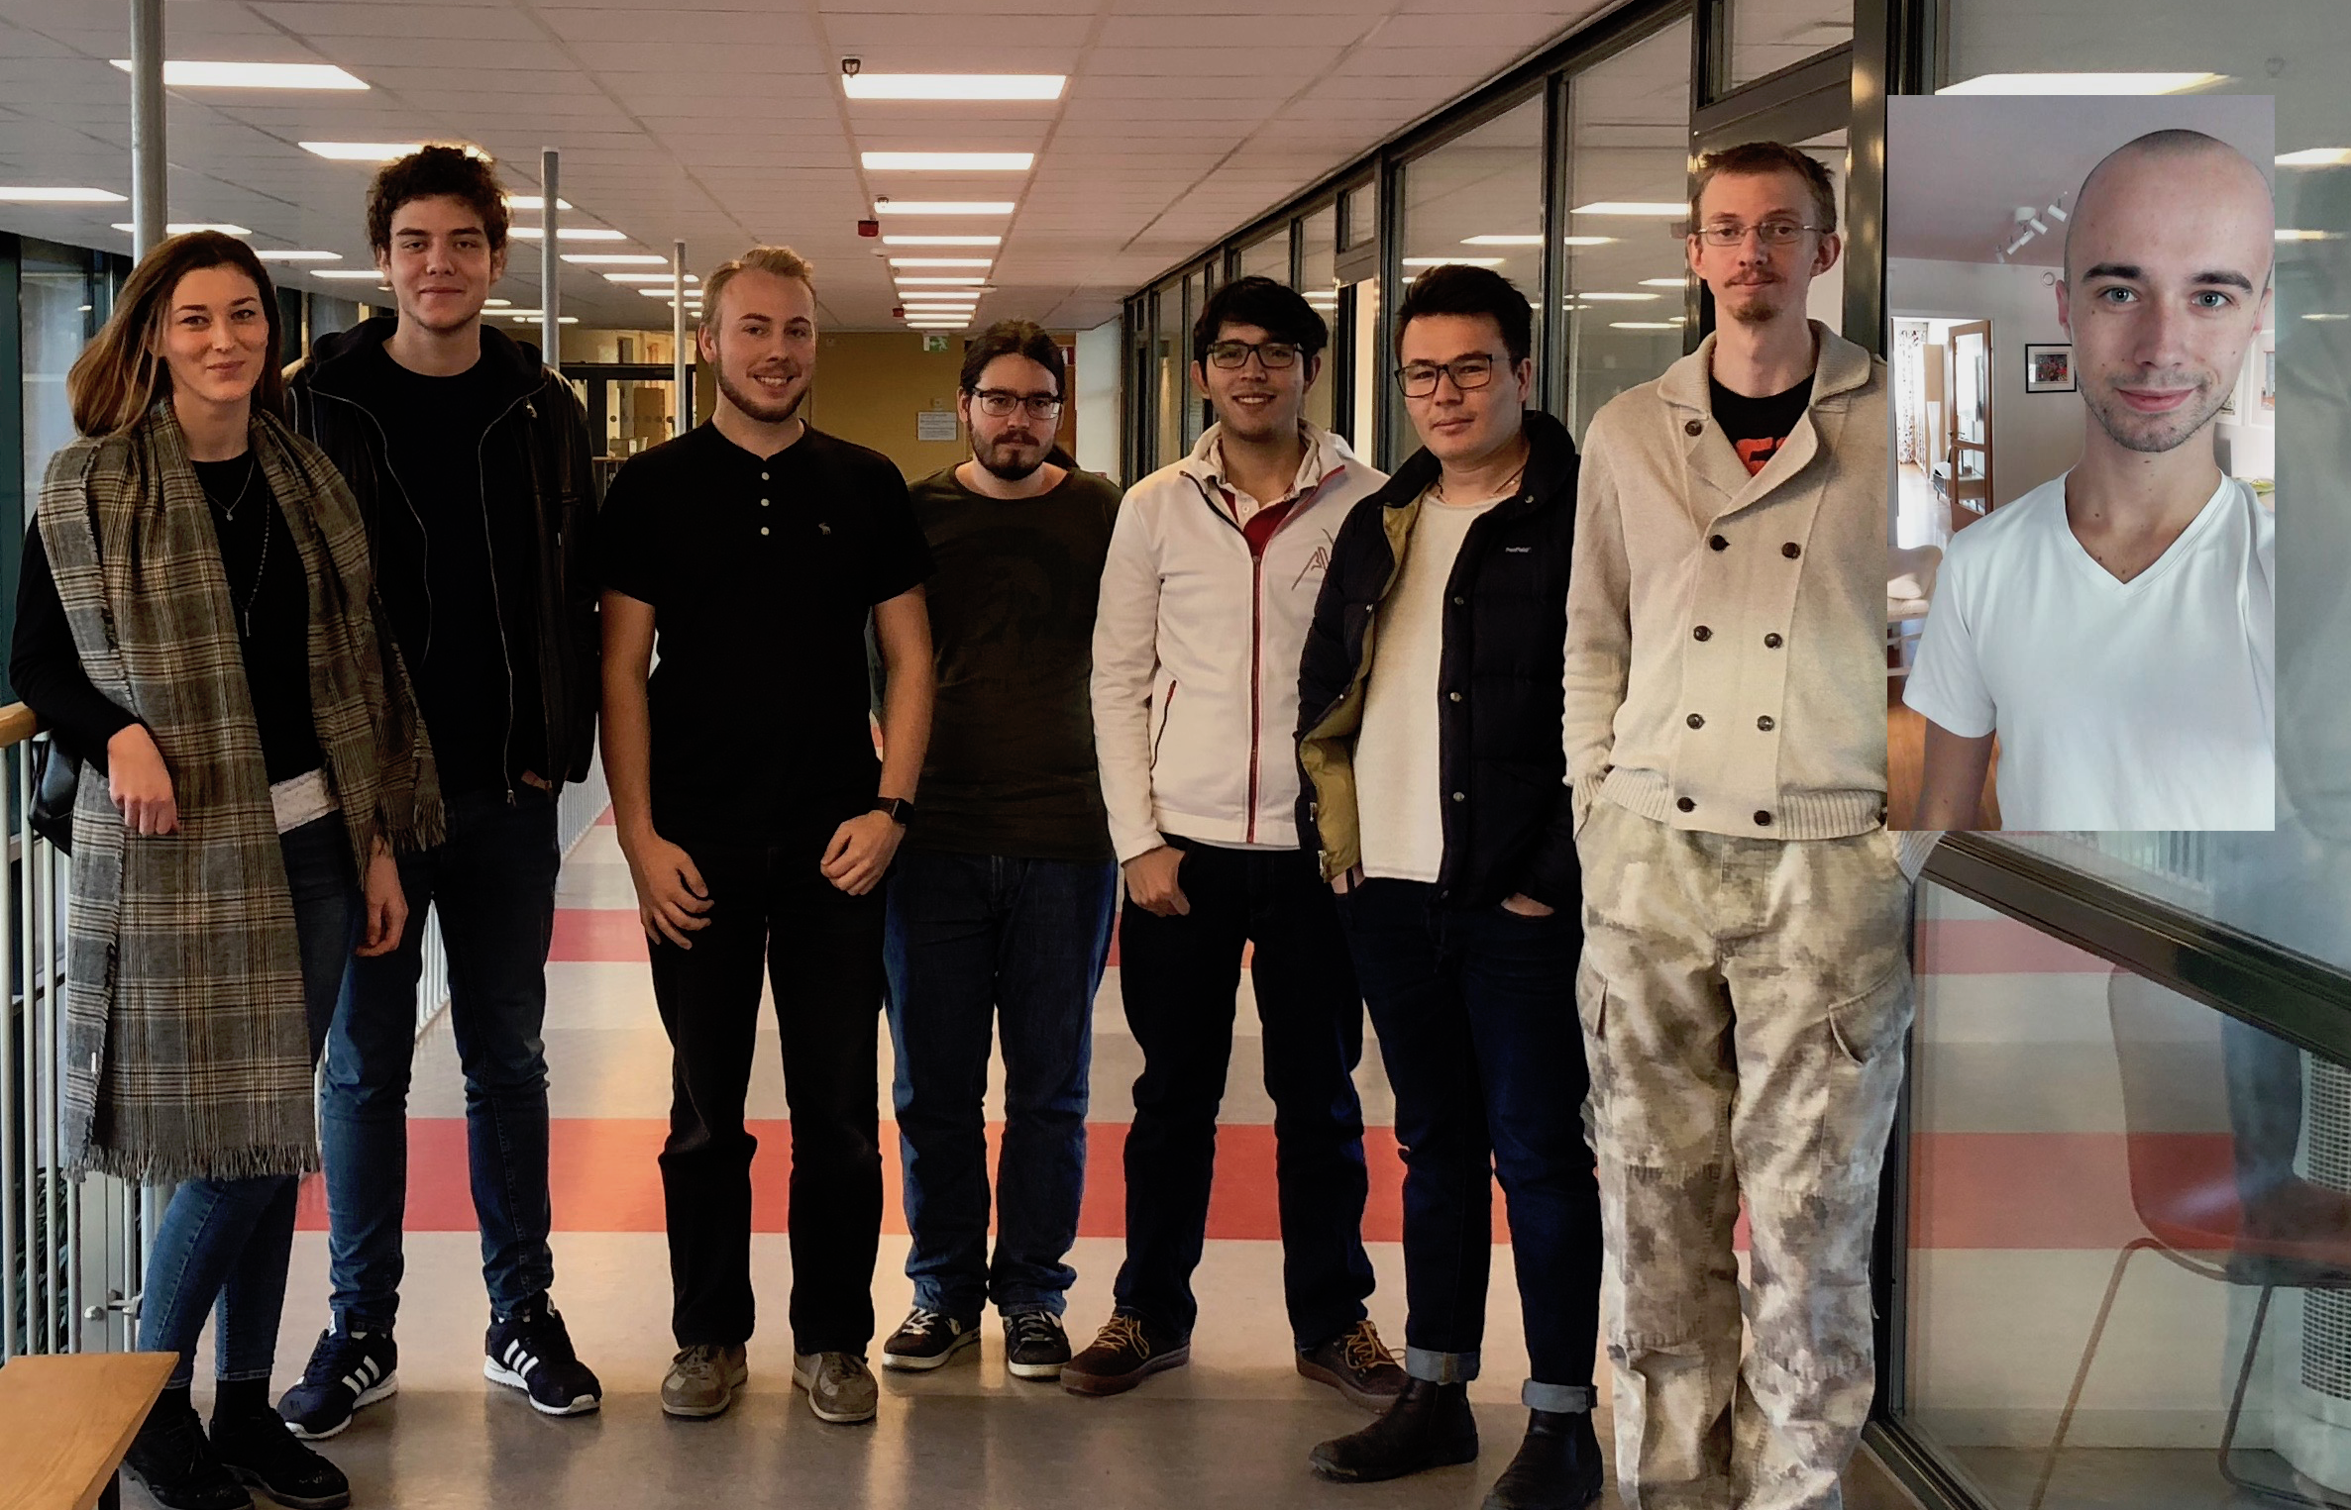
Who are we?

Slide 4
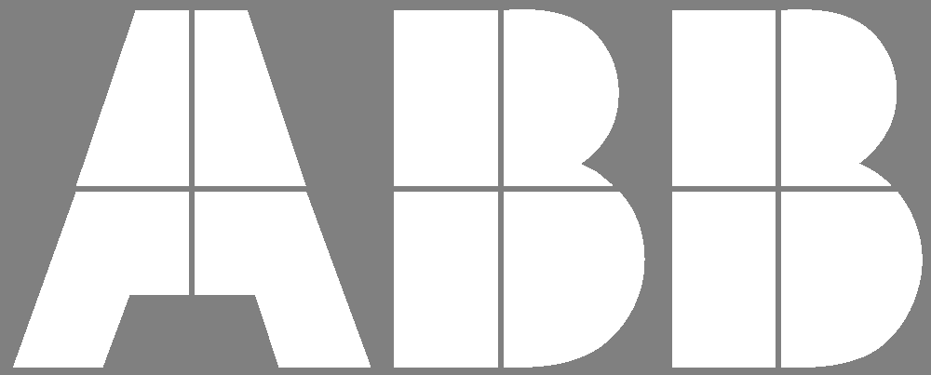
Who is our client?
ABB Ports
Christoffer Holmstedt
TeamForge by CollabNet
Notes:
Christoffer Holmstedt
Sadly, he is not here today… :(
They are keeping track of their progress by using software called TeamForge by CollabNet. It helps them to get an insight into available projects and tasks- which are called artifacts.
Even though it represents a Kanban board, they are not satisfied with it completely. It is not customizable. So, they are using post-it notes on a whiteboard.
And,TeamForge is often down..

Slide 5
What is our product?
Kanban board
Web application using TeamForge REST API
Different users with different privileges
Available
Notes:
So, they wanted us to develop more customizable Kanban board. It should enable them to create.. to drag and drop artifacts from one state to another, import, update..
This board should be a web application using TF API to collect…
No sync back with TF
Recognize 2 different types of users: admin and regular user. Naturally, admin has more privileges …, and regular user is able to drag and drop
It should be “always” available, even when TF is down

Slide 6
Project Requirements & Results

Slide 7
User Related Requirements
Feature Name | Status
Login & Logout | Done
Check current state of Kanban Board | Done
Drag & Drop cards | Done

Slide 8
Administrator Related Requirements
Feature Name | Status
View Admin Dashboard | Done
Add/Edit/Remove Category | Done
Add/Edit/Remove Swimlane | Done
Add/Edit/Remove Parent Category | Done
Set Category and Parent Category Limits | Done
Import Artifacts | Done
Select Artifacts | Done
Filter Artifacts | Not Done, Out of Scope
Card Movement Log | Done, Out of Scope
Notes:
“Filter artifacts” feature

Slide 9
Summary of Project Results

Slide 10
How did you prioritize in case you didn't have time to implement everything?
Preventative measures:
Clear project goal
Aim for minimum viable product
Out of Scope
During:
Task reprioritization
Reallocation of resources

Slide 11
High level design - Architecture

Slide 12
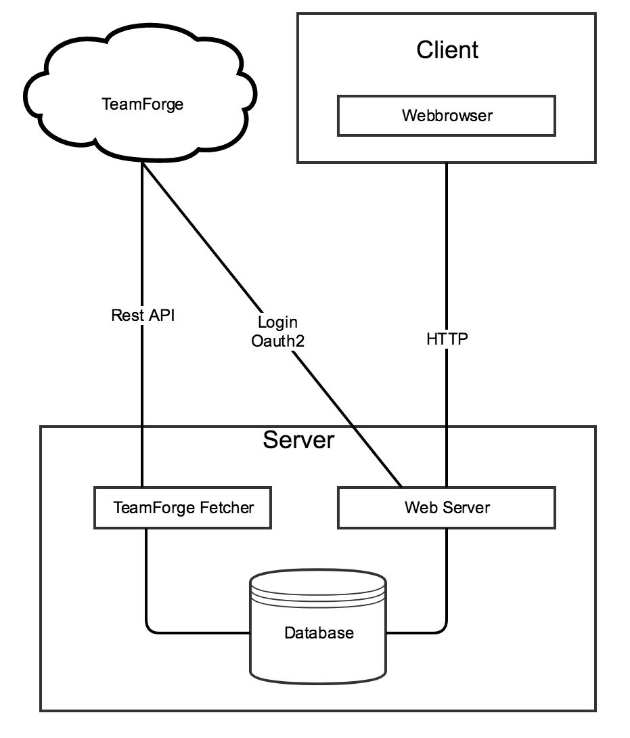
System overview
Web based application - mobile responsive
Laravel framework - MVC Architecture
MySQL server for persistent data
TeamForge’s REST API - Oauth2 for authentication

Slide 13
Qualities ensured
Application security - fetching artefacts
Synchronization and timing - real time behaviour
TeamForge and local users (both admin and regular)
Use of integrated Laravel login service

Slide 14
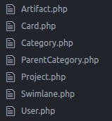
MVC Overview - Models

Slide 15
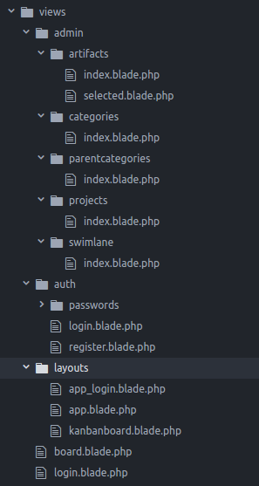
MVC Overview - Views

Slide 16
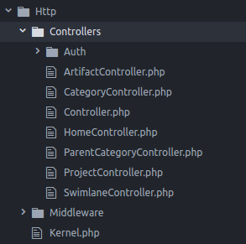
MVC Overview - Controllers

Slide 17
Live Demo
Notes:
André
- Login screen
- Board
- Parent Categories -> create new
- Categories -> add 2 to parent
- Swimlanes -> create new
- Board -> show the new parent category & swimlane
- Projects -> add Test Project
- Artifacts -> add all Artifacts
- Board -> move cards around
- Click on card title -> show artifact information
- Talk about the difference between what admins and normal users can do
- Done

Slide 18




Organization and routines changes
Notes:
Not Much, we’re still working with the same tools
To Recap: Github and git,
Slack for communication
and G-suite for collaborative editing.
We switched over from github wiki to g-suite. But that was during the first weeks before the project plan presentation.
What’s really change in the routines is that we have less meetings.
We still have meetings for planning.
But In the implementation phase we work on our own and communicate over slack.

Slide 19
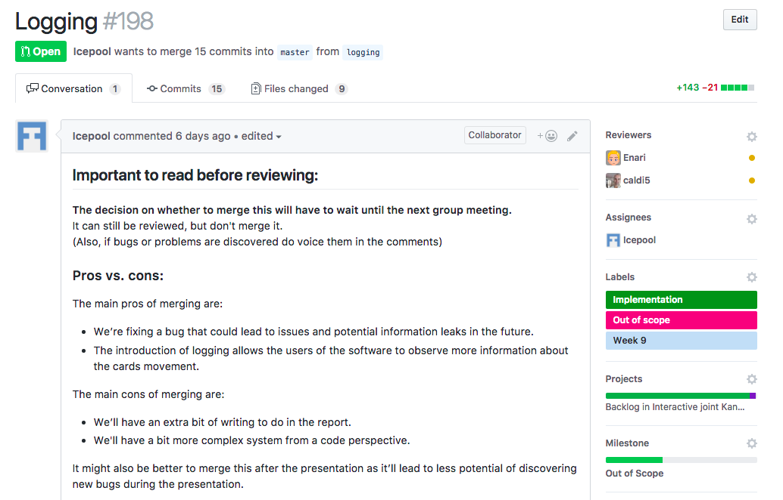
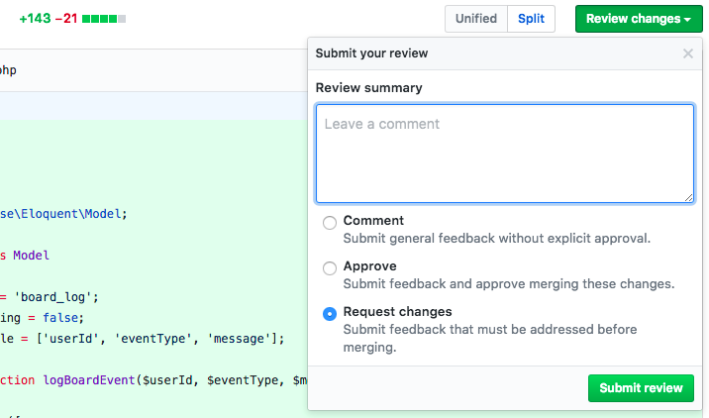
Organization and routines changes
Notes:
Another thing that changed was the way we review code.
For code reviewing we started to use the review tools provided by github for pull request.
It automatically suggest who should review the code. and they can comment, make changes and g

Slide 20
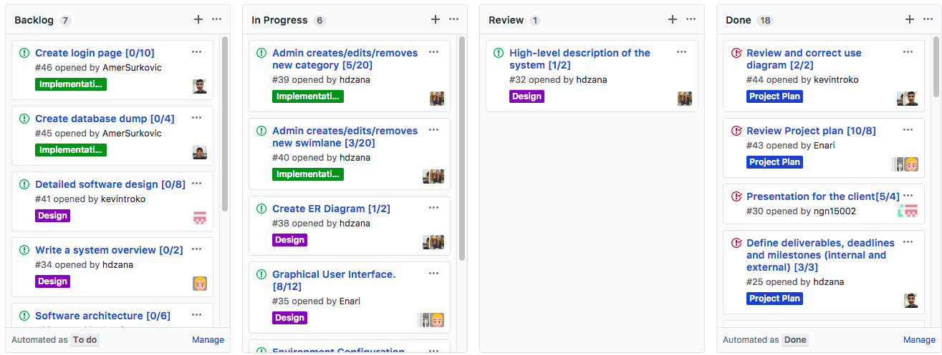
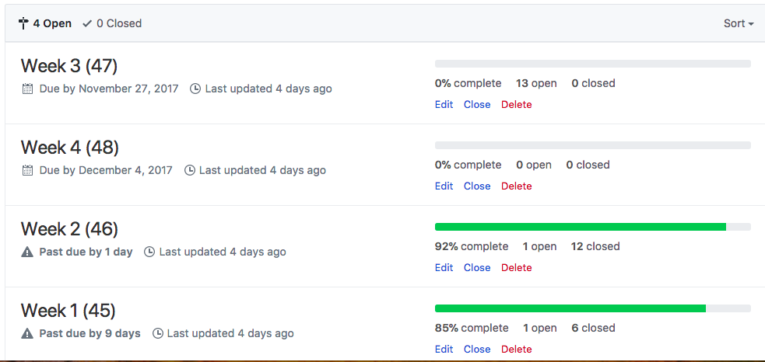
Division and synchronization of work
Notes:
During our weekly planning meetings we summariced how the previous week had gone, if anyone needed help.
Then we create github issues for what we should do the next week.
Each member can the assign themself to the issues they want to doa

Slide 21
Did the initial plan hold up?
Nope...

Slide 22
Why didn’t the original plan hold up?
Access to Teamforge
Group member dropped course
Overhead for meetings and planning
Time Estimations was off
Lacking understanding of the technologies
Notes:
It took us over a month to get access to Teamforge.
At the start of the project this wasn’t a problem.
When we were a few weeks in, we were getting worried. and started working on a backup plan.
Luckyelly we got access the next week.
Since we became

Slide 23
How we managed changes?
Reprioritization
Working in iterations

Slide 24
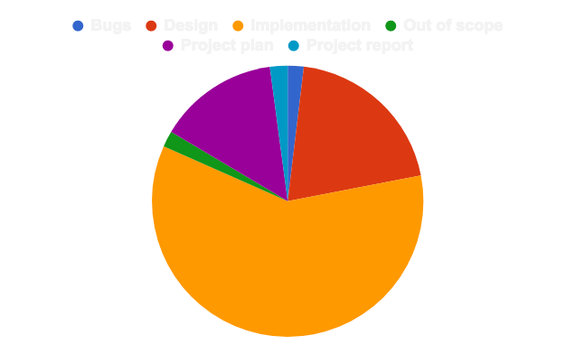
Activities and worked hours summarized.
Time Planned: 1200
Time Planned: 1050
Total Time: 1112

Slide 25
Experiences

Slide 26
What did you learn from the project?
“If you don’t actively attack the risks on a software project,
they will actively attack you.”
Steve McConnell
Notes:
Planning, designing and implementing a final product in a teamwork. this is the main focus of the course.
You don’t really need to have worked in a team work before to know it is challenging. No matter the kind of project it is.
Anyways this project helped us to relearn some things.

Slide 27
What did you learn from the project?
Communication with the client is key.
Implementation of concepts of previous courses is the best way to learn.
Little taste of how the industry works.
Complementation between members.
The most important thing in every software project is the planning
There is people with different motivations and goals.
Team manager is key
Notes:
The communication with the client is the key. It saves a lot of time, because it removes requirements modifications in later on phases of the project. In our team we meet the client the first day of the course. And we keep it up in emails in order to know that we were on the right track.
This course is a perfect way to implement the concepts learned in theory-based courses like software engineer one, or also technical courses like web-development and databases.
The interaction with a real client motivates the team to work harder. In the end there is an end user waiting for a good result. So there was more than just good grades in this course.
There were members who know more about backend or Laravel, for other teammates designing the Kanban board was their main focus.
No code from the first day, The most important thing in every software project is the planning. But although small projects can succeed with some luck. Bigger projects require more planned approach. For us it was really well done, and the Fridays before the steering meetings were a nice way to measure the advance of the project and which direction to take the next step.
This point is something you can see with both sides of a coin, either you find interesting to work with people you’ve never meet, or it could be a really hard time to deal with uninterested members. The level of dedication and interest should be the same (or at least similar) in order to don’t have problems with members falling behind.
It is impossible to have a project heading to the right direction without a team manager in charge of it to control it. It must be somebody with great social skills and with a great sense of responsibility. And to understand members of what is happening in their lives.
We learned that there should be a lot of honesty, be truth of what you can and what you can’t do.

Slide 28
What will you improve the next time?
Be to be aware of your capabilities.
Follow the deadlines.
Don’t ignore the tips.
Try to complete as much as possible before Christmas.
Communication among team.
Notes:
Be to be aware of your capabilities, don’t assign tasks that are not possible to do by yourself, this will keep you motivated
Follow the deadlines that are in the course web page and follow this advice, ignoring the tips from people who had this course before is just ignoring the experience that we as a team got in this period.
Try to complete as much as possible before Christmas. During the holidays the amount of work done is decreased significantly.
Communication among team member might be the most important thing ever. If good communication doesn’t exist people will have different ideas of what the team needs to achieve. So it’s really important to sort out what view of the final product everyone has as soon as possible, so that everyone can work toward a common goal.

Slide 29

What were the problems?
Holidays
One member less
Access to Teamforge
Notes:
One member dropped the course, so the work needed to be reassigned.
Holidays happened in the middle of the course, this made some members inactive during almost one to two weeks.
Getting Teamforge was very time consuming.

